Slide 1

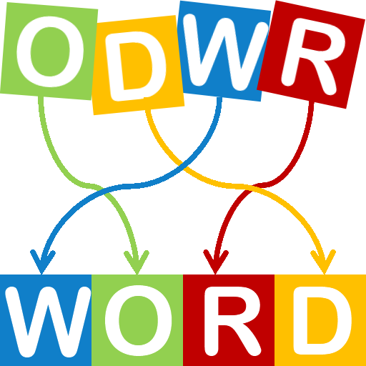

The perfect solution for generating struggling words from games.
https://github.com/ksu-is/CodedLetters
Developer: Nathan Pool
Original code attributed to peterapps.

Slide 2
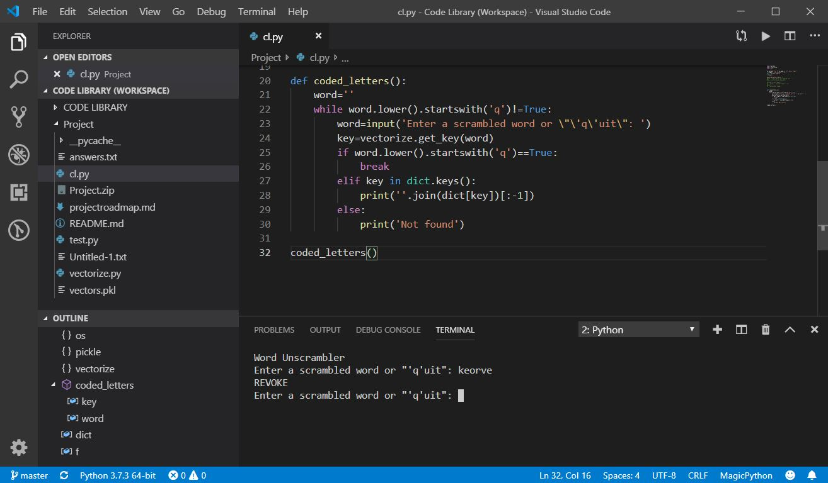

The perfect solution for generating struggling words from games.
Developer: Nathan Pool
https://github.com/ksu-is/CodedLetters
Original code attributed to peterapps.

Slide 3
The perfect solution for generating struggling words from games.
Modified scrape program.
Scraped 6,000 web pages.
Vectored list into dictionary.
Replaced original dictionary
Developer: Nathan Pool
https://github.com/ksu-is/CodedLetters
Original code attributed to peterapps.

Slide 4
The perfect solution for generating struggling words from games.
To-do:
Code program to return more words.
Convert completed program to iOS platform with BeeWare.
Developer: Nathan Pool
https://github.com/ksu-is/CodedLetters
Original code attributed to peterapps.

